Slide 1

NIH workshop (NIEHS/NHGRI, May 24-26, 2022) https://www.niehs.nih.gov/news/events/rnaworkshop2022/index.cfm Capturing RNA Sequence and Transcript Diversity, from Technology Innovation to Clinical Application
Kin Fai Au Lab
May 24, 27 and 31, 2022
Department of Biomedical Informatics
Ohio State University

Slide 2
Group discussion on 5/24/2022 (Kin Fai Au)
Kin Fai Au (KFA)’s thoughts
Learn boundary or limitation of different seq data
Develop methods to solve problems utilizing strengths of the data
Hybird: LR + SR, which part/section can/should be integrated to improve performance
Suggest to Haoran to develop platform to allow
individual users without computational resource; we help them do analyses; they share data with us
data mine -> new findings
construct analysis pipeline, and visualization
m6A; the linkage information provided by long reads needs to be mined.
Dingjie Wang (DW): add all tools in the pipeline
KFA: not necessary at this moment, only focus on popular ones based on benckmark papers
Understand complexity and diversity of the data in nature/real samples
KFA: e.g., look at the frequency of a given 10-mer sequence/motif in natural genome, will lower than theorical calculation
Yunhao Wang (YW): benefit the generation of gold standard to reduce cost
Co-occurance between sequence, structure, mods, post-transcriptional events (alternative splicing and others): innovative statistical/other method development -> novel findings

Slide 3
Group discussion on 5/27/2022 (Aifu Li)
Aifu Li (AL)’s thoughts
Capture multiple different RNA modifications on the same RNA molecule
KFA: of >150 RNA mods, it is important to know which ones can be detected by ONT, not limited by the well-known m6A; the linkage information provided by long reads needs to be mined.
YW: when talking about RNA mods, the RNA species should be considered, mRNAs and non-coding RNAs.
Generate gold standard/reference for RNA modification detection
KFA: challenge to generate positive controls, cost a lot.
Identify the RNA mods with the most important biological functions
Bo Li (BL): agree, but need more efforts from the whole RNA community
RNA mods on RNA virus, RNA mods vs RNA localization
KFA: both of them are interesting, need methodology development; more importantly, co-occurrence (association) between RNA events/mods/others

Slide 4
Group discussion on 5/27/2022 (Haoran Li)
Haoran Li (HL)’s thoughts (see Haoran’s slide for more details, Page 9-10)
Difficulty in computing and sharing resource
Analysis reproducibility and standards
KFA: using public platform, such as GitHub, to customize analysis pipeline
Appyter
KFA: high computing cost for data processing
Gene ananotation
Single molecules vs averaged ones

Slide 5
Group discussion on 5/31/2022 (Ying Zhang)
Ying Zhang (YZ)’s thoughts
RNA mod detection solution: convert mod to mutation profile by RT (reverse transcription) enzyme
KFA: convert/detect multiple mods to specific mutations, on the same molecules
KFA: suggest to HL, computationally, de novo detection of new modification by new signal in raw data
YZ: new RT enzyme development
YW: efficiency/sensitivity, specificity (one mod to one mutation pattern, one to multiple) sing public platform, such as GitHub, to customize analysis pipeline
BL: like bisulfite seq for DNA
Hsin-Lun Hsieh: convert one mod -> another mod -> enhance detection signal
KFA: the same as we are doing for DNA 5hmC with Jerry’s lab now
RNA secondary structure by mod footprint
KFA: alignment <10% for direct RNA-seq on heavily-modified RNA molecules; mutation solution improves alignment, because more accurate base-calling; new aligner to handle mutated sequences
YW: need new base-calling methods plus gold standards (positive control)

Slide 6
Group discussion on 5/31/2022 (Bo Li)
Bo Li (BL)’s thoughts (see Bo’s slide for more details, Page 11-15)
Function difference of isoforms with small sequence difference but with different folding pattern
YW: structure determines function
Standards for RNA mod detection in different cell/tissue types
YW: standards not just for cell types; more imperatively, standards for method development
Find good application target, biologically significant

Slide 7
Group discussion on 5/31/2022 (Dingjie Wang)
Dingjie Wang (DW)’s thoughts (see Dingjie’s slide for more details, Page 16-22)
Isoform-specific function
Quantitative analysis
Bias in library preparation and sequencing platforms/strategies to consider for method development
Xiaoyu Cai: agree, need understand which bias has big effect
Collection: tools and datasets for direct RNA-seq
RNA input requirement, from 100 ng to 1 pg
AI/ML for direct RNA-seq method development
User-friendly platform and gold standard

Slide 8
Group discussion on 5/31/2022 (Yunhao Wang)
Low-input RNA-seq
high-efficient RNA ligases to allow efficient adapter ligation
sequencer capture efficiency
Standards and methods for RNA modification detection
synthesis, ligation ...
antibody, NMR, MS, direct RNA-seq
RNA structure
experimental approach
computation: far from the knowledge of protein structure (AlphaFold)
Interactions
RNA sequence, post-transcriptional events (AS, APA), modifications, structure, RBP

Slide 9


Capturing RNA Sequence and Transcript Diversity - From Technology Innovation to Clinical Application
Haoran Li
Department of Biomedical Informatics
Ohio State University
5/27/2022

Slide 10
Critical Computational Resources
Analysis reproducibility (raised by Ali Mortazavi & Phil Bevilacqua)
Difficulty in sharing & comparing results for ~100 datasets
Raising standard for paper review
Central repo that documents software code used for analysis
Docker containers to reproduce environment
Communication between data scientists & other researchers (raised by Ali Mortazavi & Phil Bevilacqua)
Jupyter notebooks to automate dataflow (https://appyters.maayanlab.cloud/#/)
High cost for processing data (even on Cloud)
The gene annotation to capture what they are expressed
How to represent results given use of different cell types;
Gene annotations should capture what they are expressed understand where RNA mods are occurring
Coding culture promotion
Difficult to get access to RNAseq data via dbGAP (Phil Bevilacqua)
prohibits global analysis and more study focused

Slide 11
Summary on RNome workshop
Bo Li
05/31/22

Slide 12
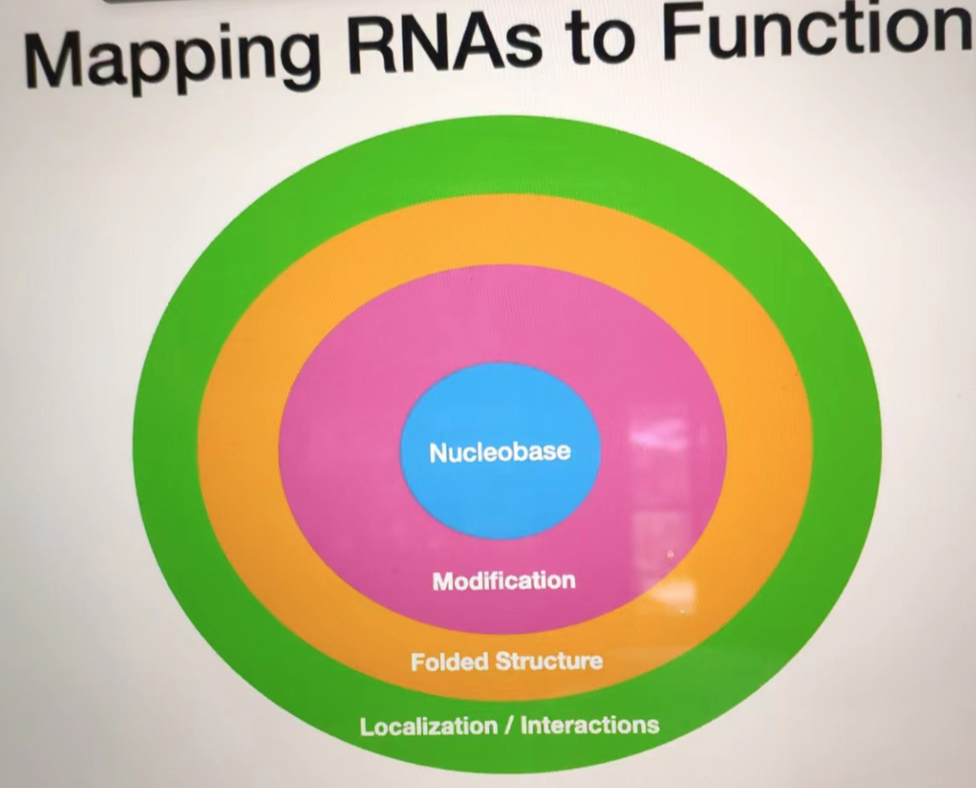
1. What is RNome?
Sequence – Modification – Structure – Localization/Interaction - Functions
Isoforms with slight difference in sequences may have distinct functions due to the folded structure.
Yunsun Nam, UT Southwestern

Slide 13
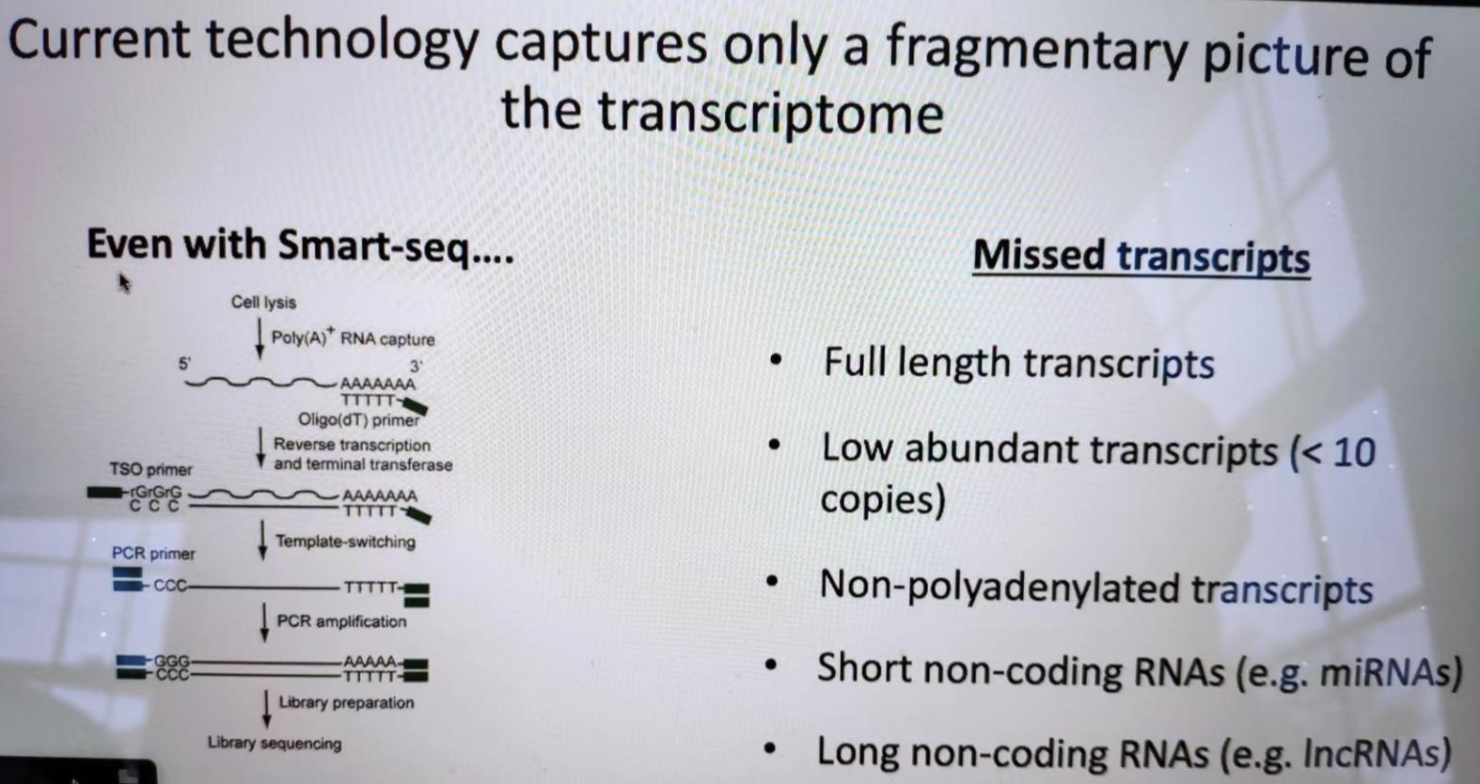
1. What is RNome?
Different types of RNA and diverse functions
Desire technology to capture the full picture.
Anna Pyle, Yale

Slide 14
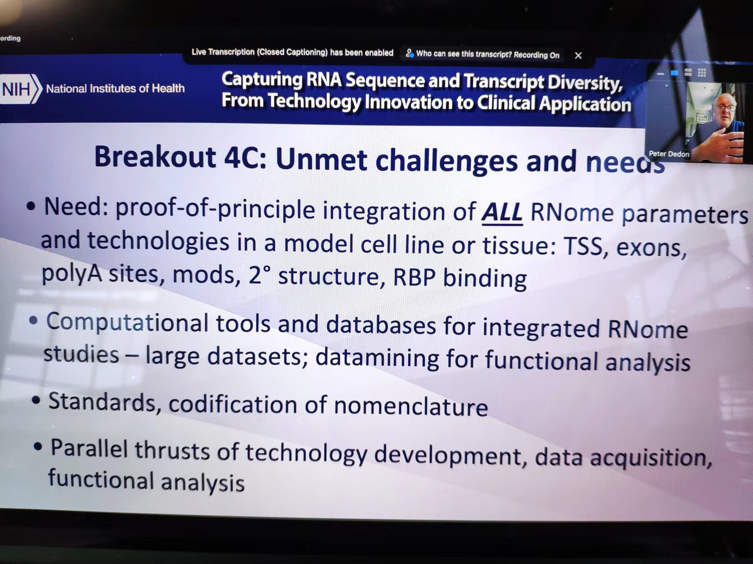
2. Opportunities and challenges in RNome
Transcript standard in certain cell line or tissue
Modification standard
Tech: Nanopore direct RNA sequencing
RNA mods

Slide 15
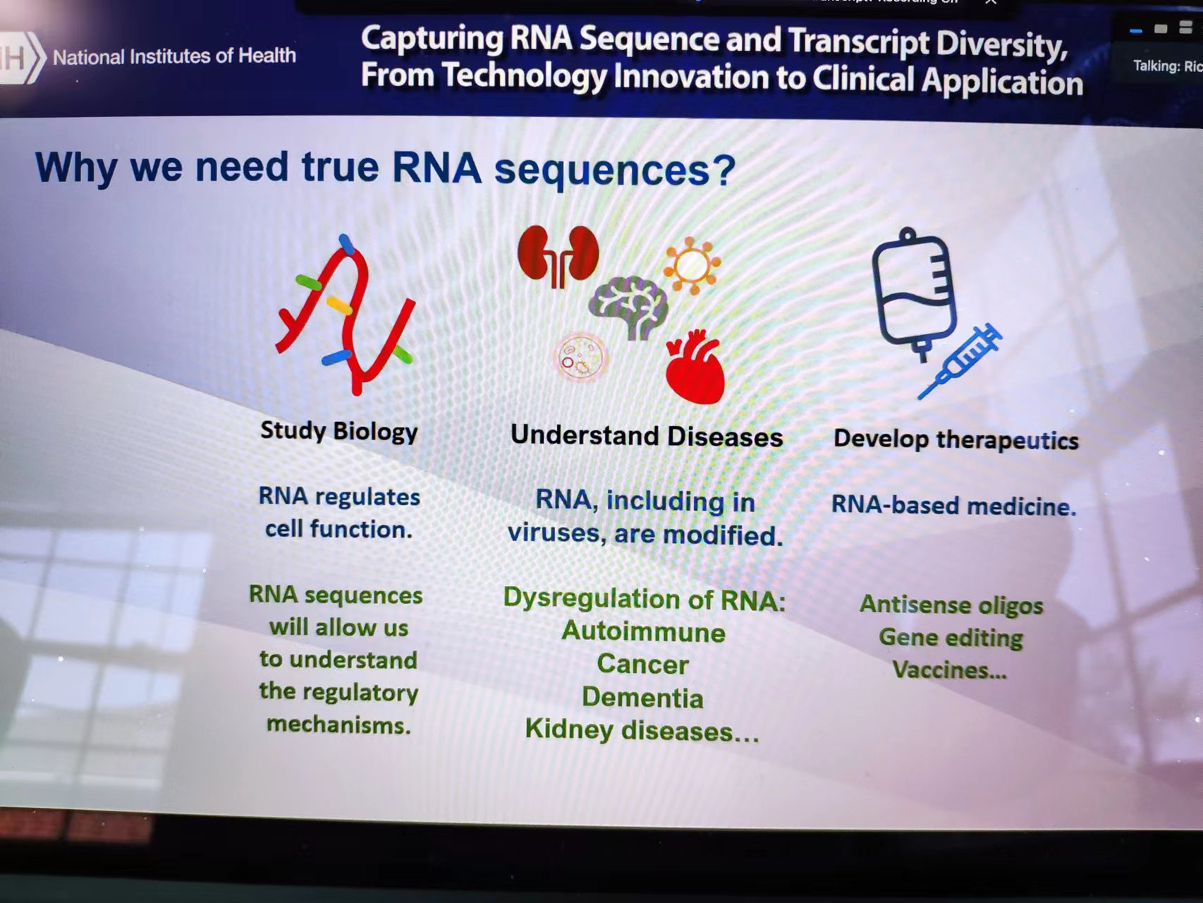
3. Application and translation
Understanding biological functions
Human health

Slide 16
Capturing RNA Sequence and Transcript Diversity - From Technology Innovation to Clinical Application
Dingjie Wang, PhD
Department of Biomedical Informatics
The Ohio State University
05/31/2022

Slide 17
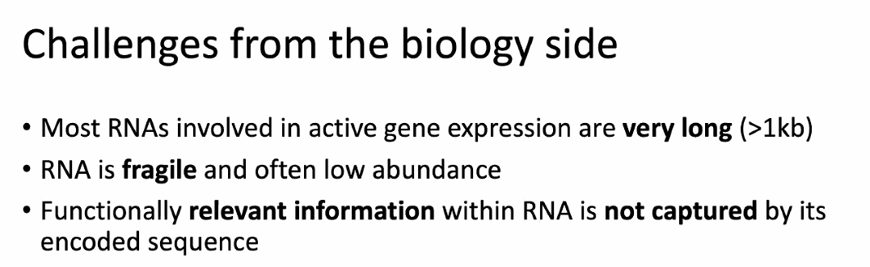
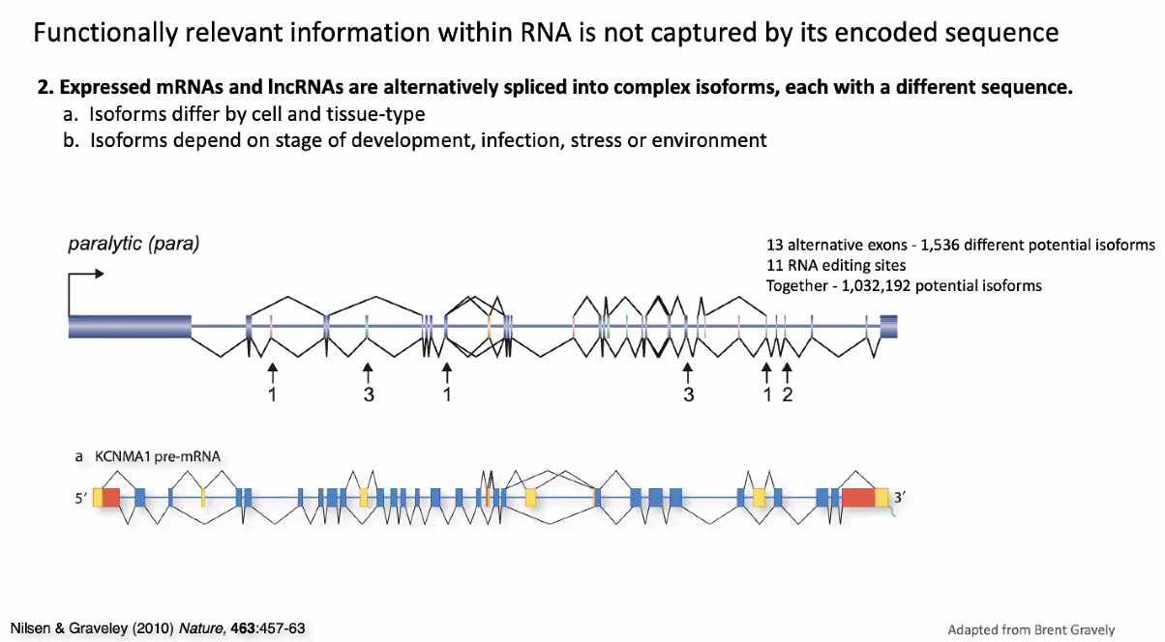
Transcript diversity and specific function prediction
Anna Marie Pyle, Yale university
Samie Jaffrey, Weill Cornell Medicine
Once we have a good sense of transcript diversity, another major question is which ones are biologically important, and which ones are just stochastic missplicing errors that have no biological consequence.
Kin Fai Au, OSU
And the next question is which isoforms have isoform-specific functions
Angela Brooks, UCSC
Agreed with Kin Fai! We have very little knowledge of isoforms-specific functions

Slide 18
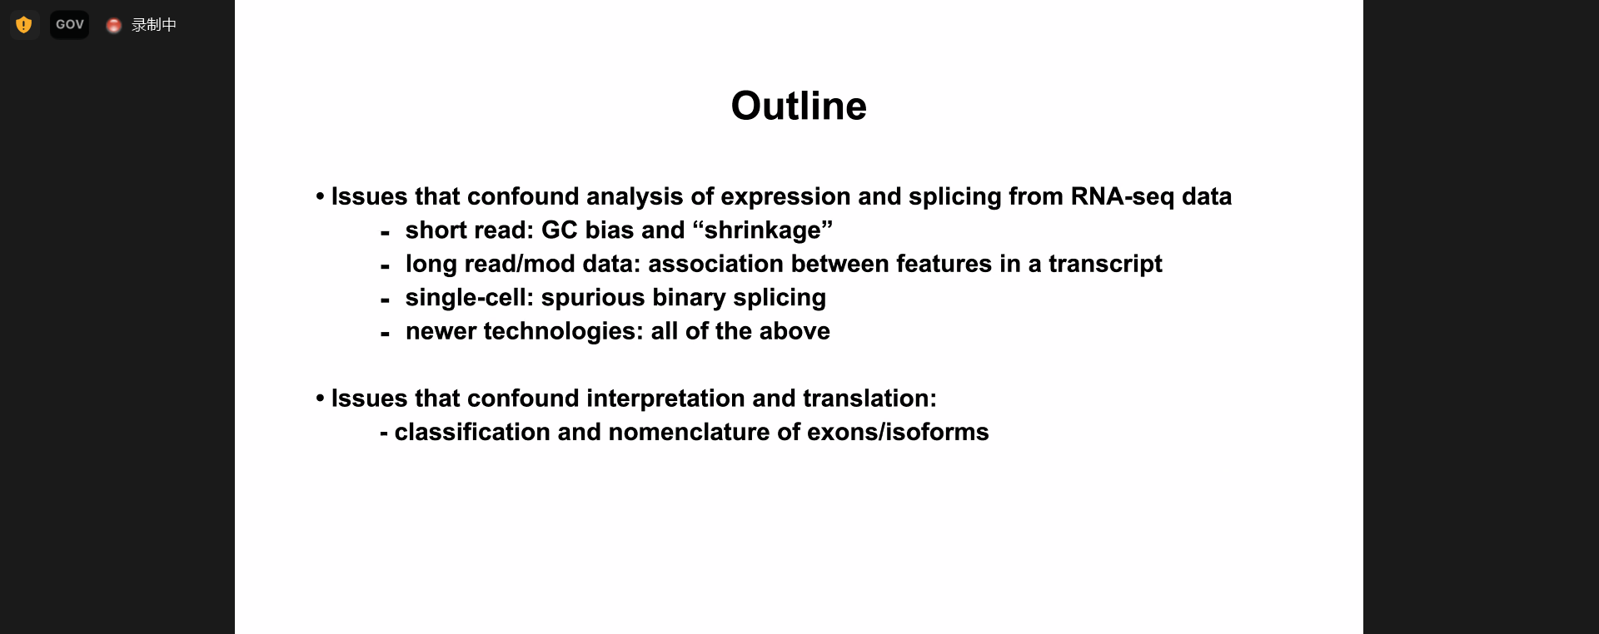
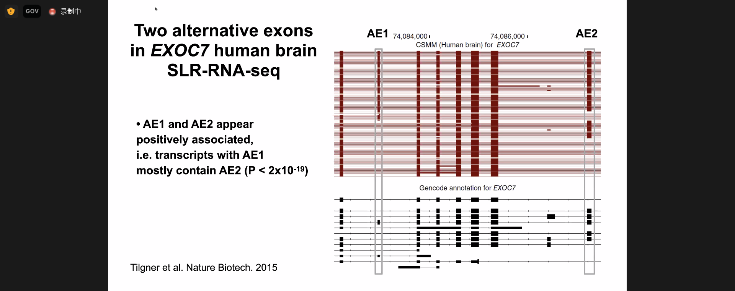
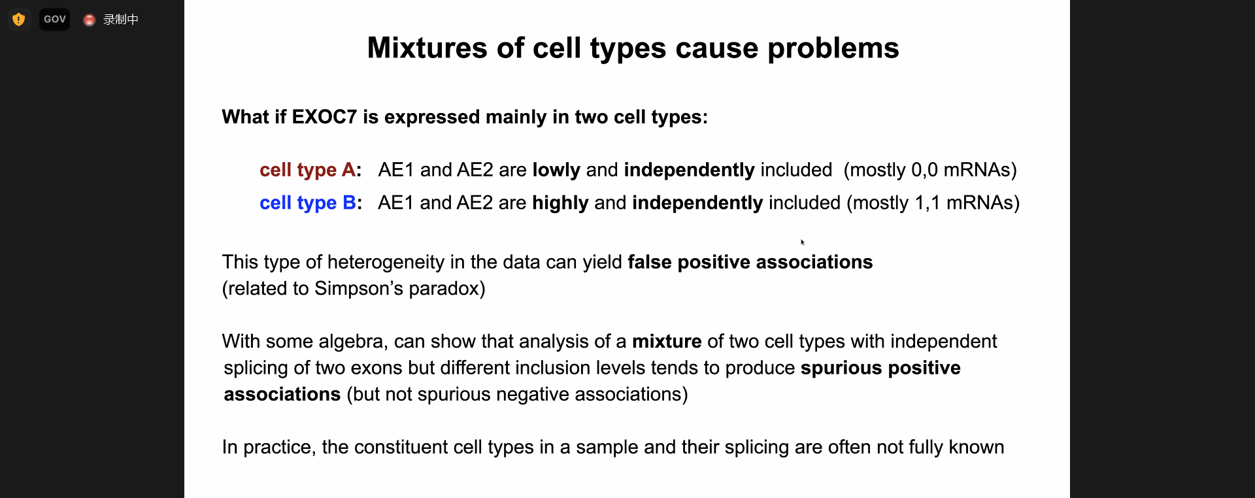
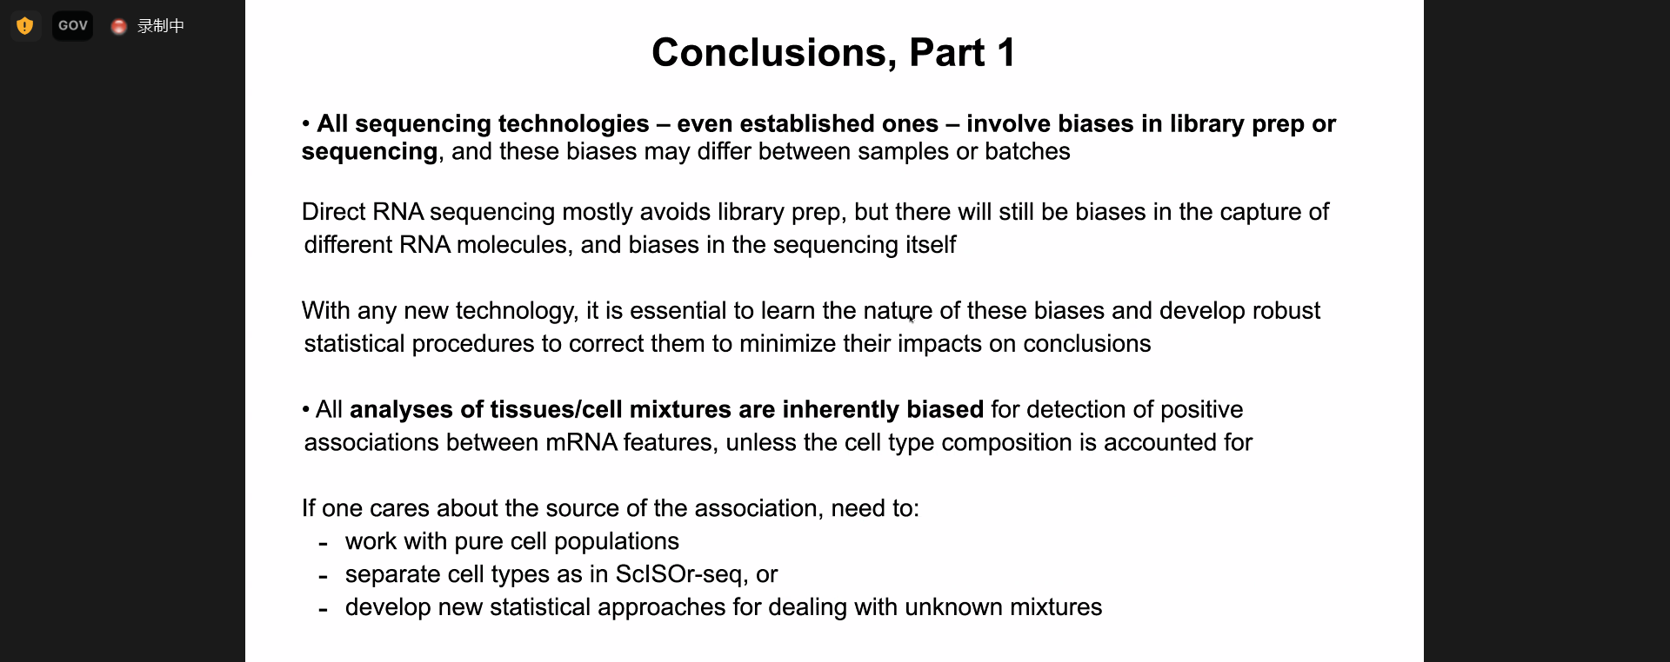
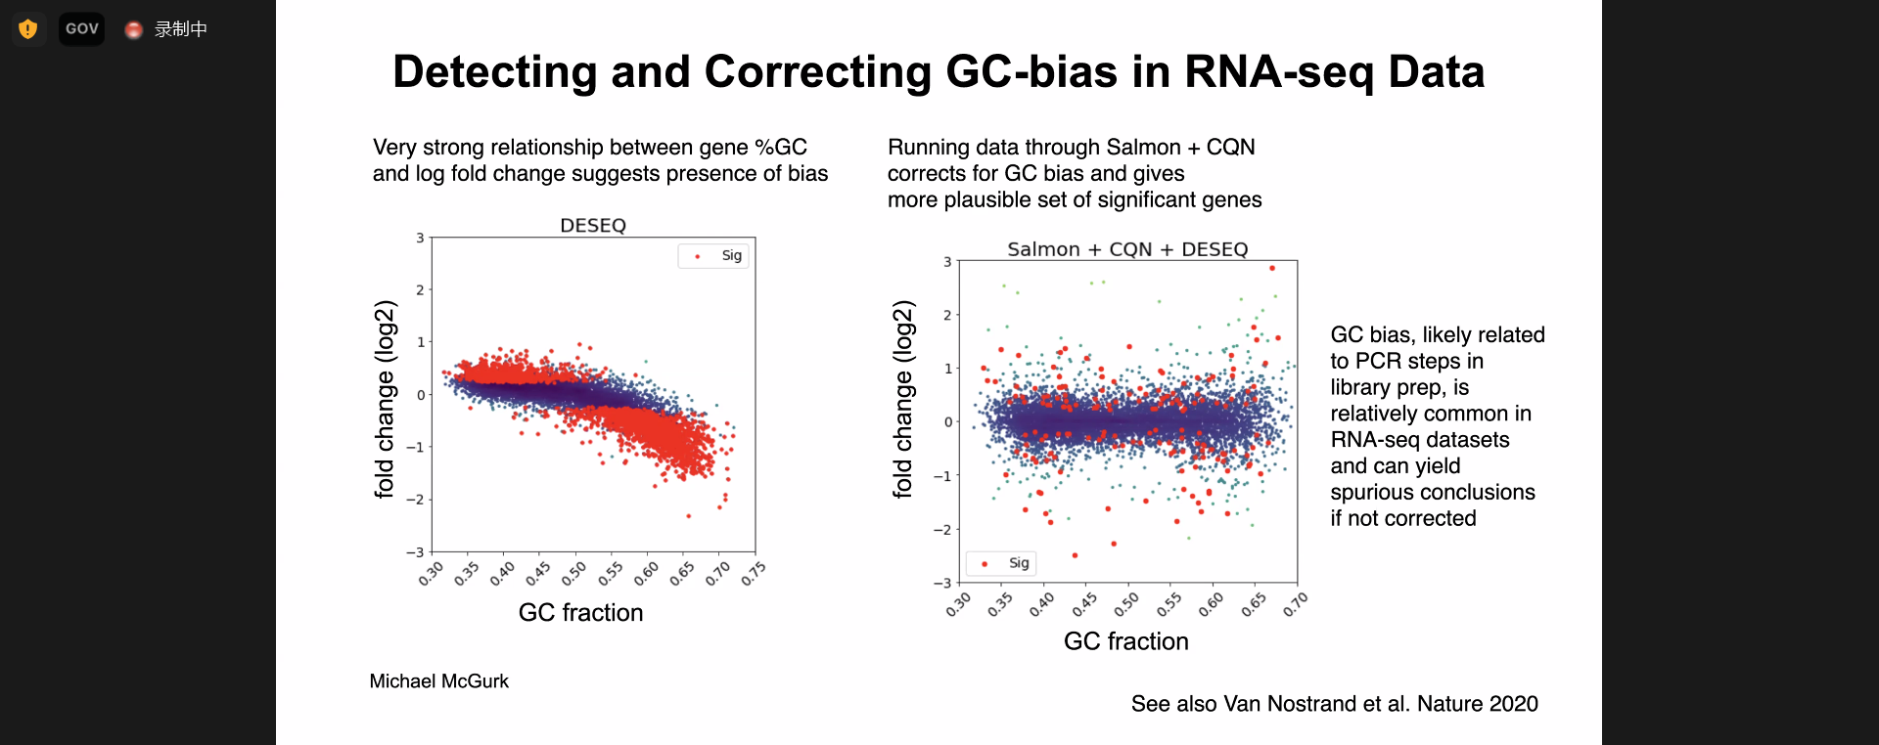
Confound analysis of expression and splicing from RNA-seq data
Chris Burge, MIT
What features affect quantitative analysis?
Technology biases
Gene features
Single molecule and single cell

Slide 19
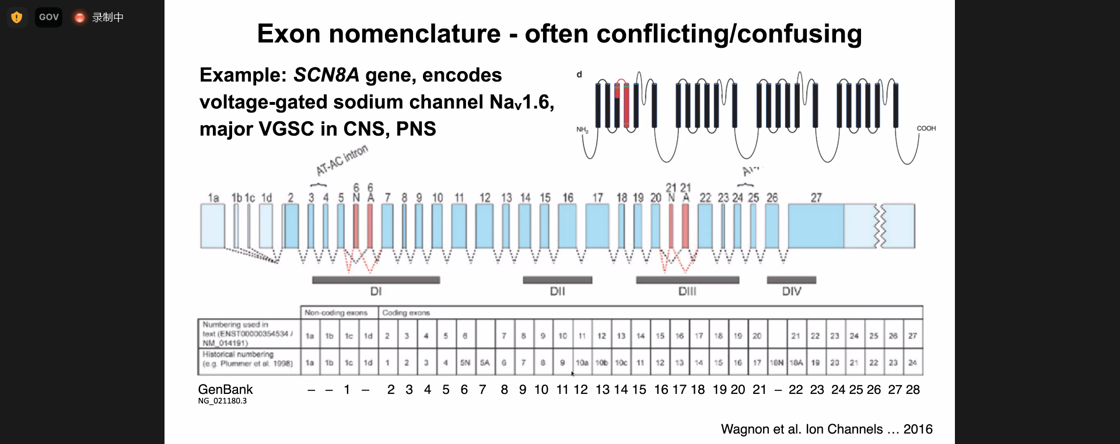
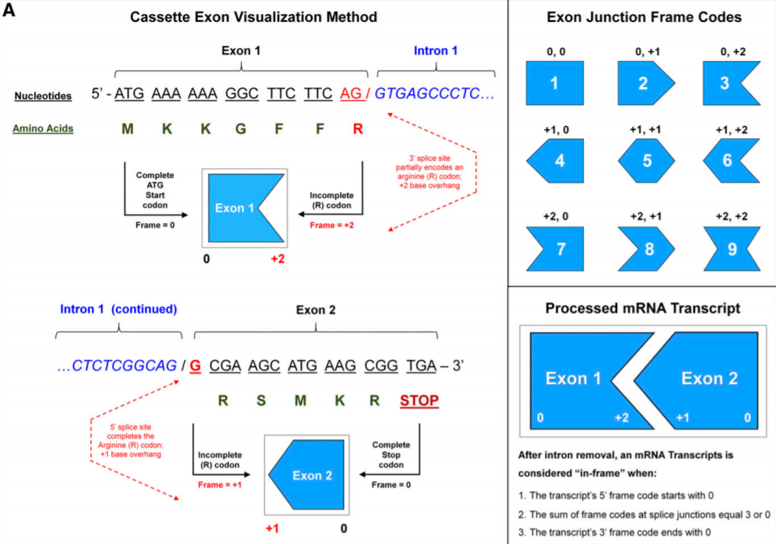
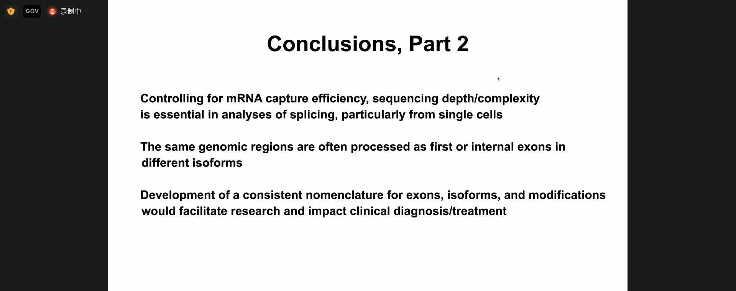
Confound analysis of classification and nomenclature of exons/isoforms
Chris Burge, MIT
Kin Fai Au, OSU
I would suggest to re-define "exon/intron" by defining "unsplicable elements: that is, using all splice sites to split the gene body into smaller bins (than the conventional exons). Each such bin are the basic unit to define gene isoform structure. For example, the alternative 5' splicing event can be defined as the alternative combination of two such bins. This generalized definition may help to standardize the nomenclature
Jo Yeakley, BioSpyder Technologies
Andrew Annalora (Oregon State University) has a variant graphical representation of exons (Drug Metabolism and Disposition April 2020, 48 (4) 272-287; DOI: https://doi.org/10.1124/dmd.119.089102) where instead of rectangles for exons, he bumps out the 5' or 3' edge to indicate coding frame, so it's easy to see where a cassette exon maintains coding frame of the rest of the transcript. This seems like an accessible way to find the low hanging fruit for splice variants that are likely to be biologically important.

Slide 20
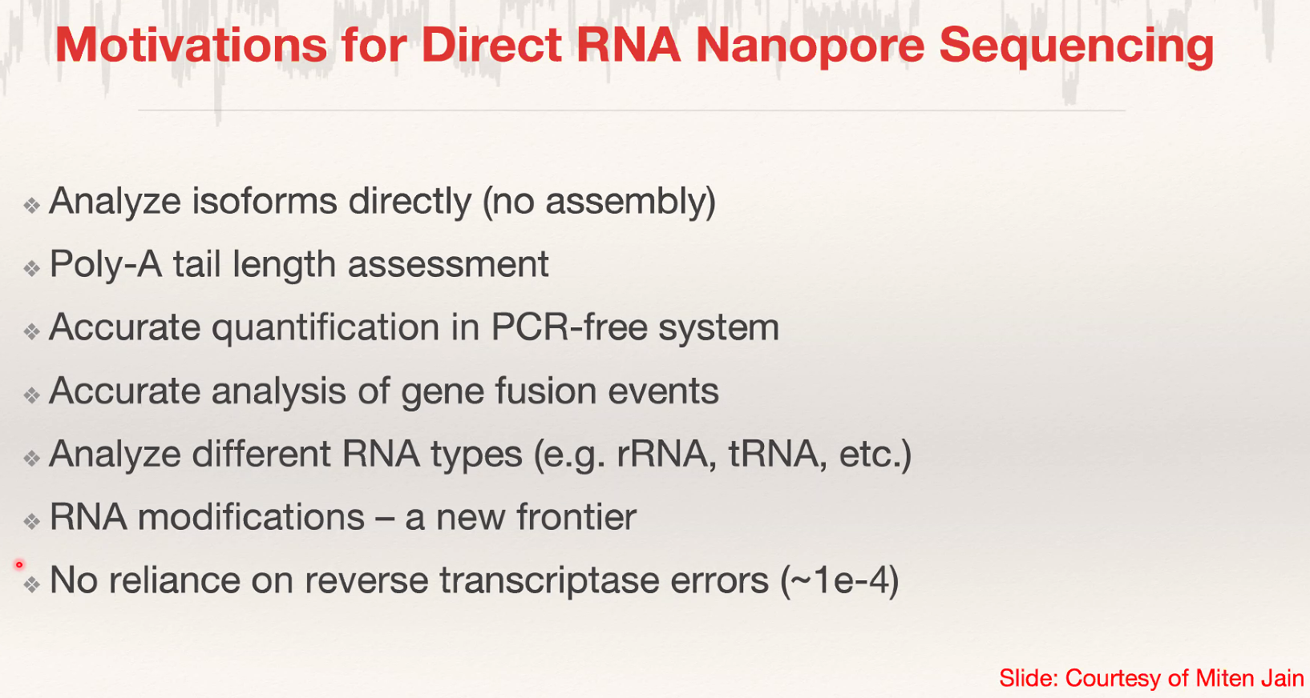
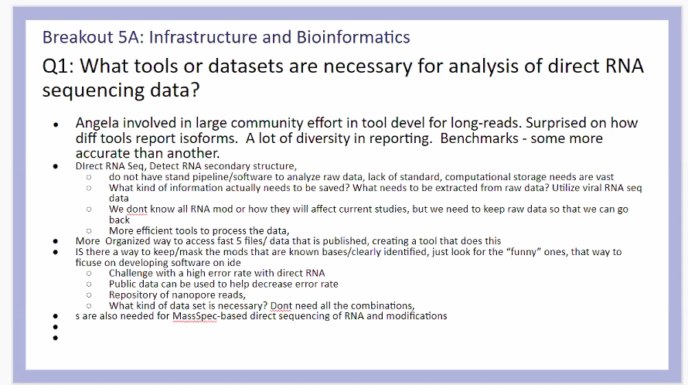
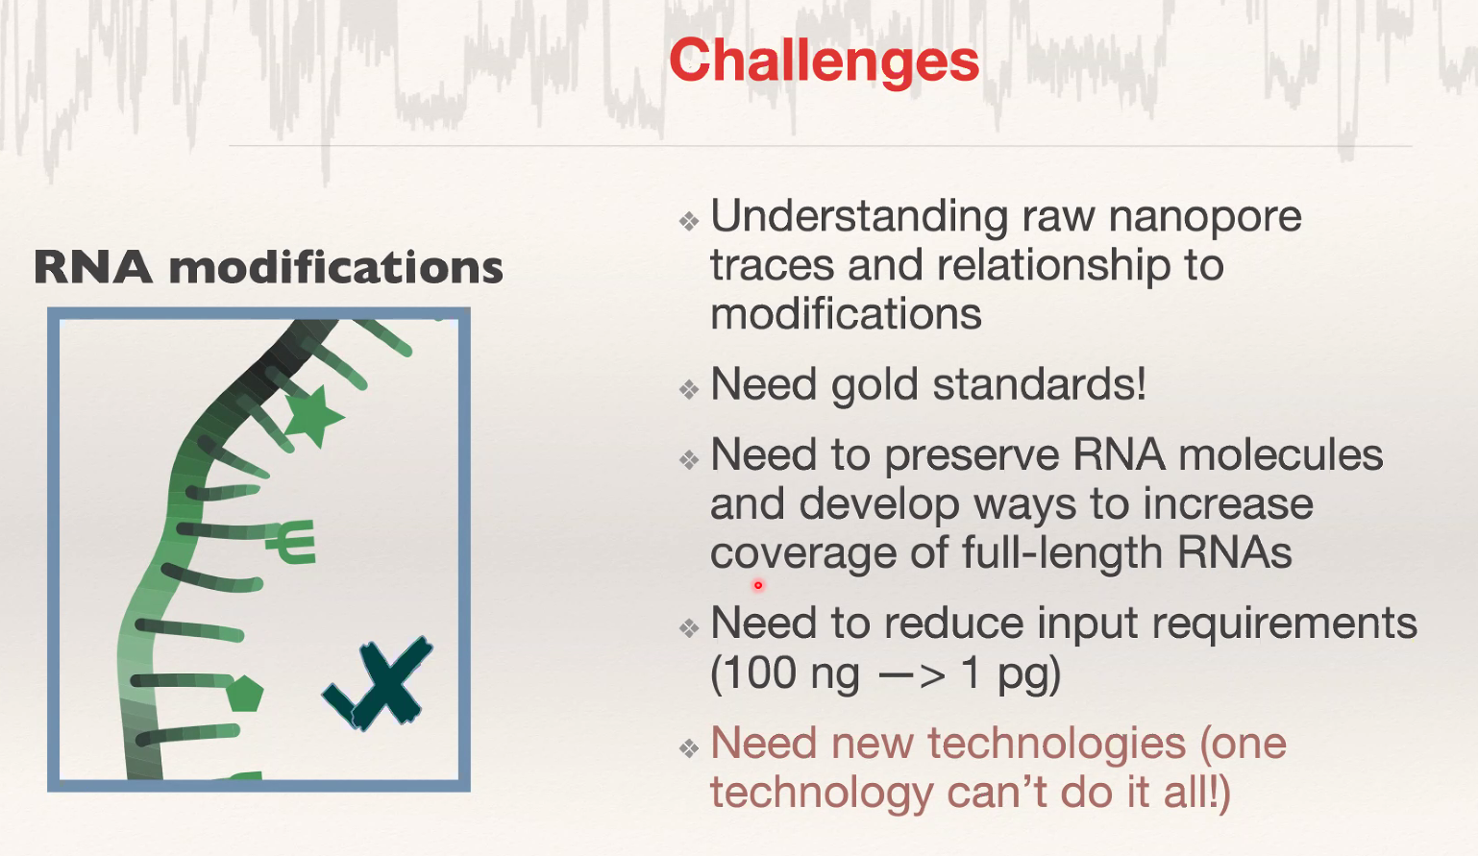
What tools or datasets are necessary for analysis of direct RNA sequencing data?

Slide 21
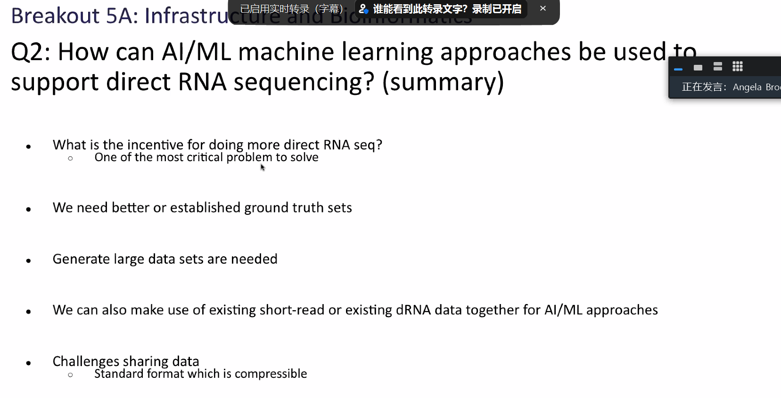
AI/ML machine learning approaches in dRNA sequencing

Slide 22
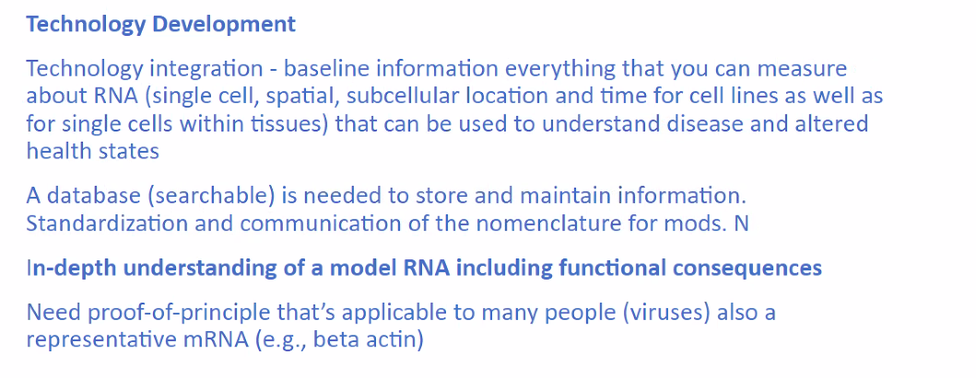
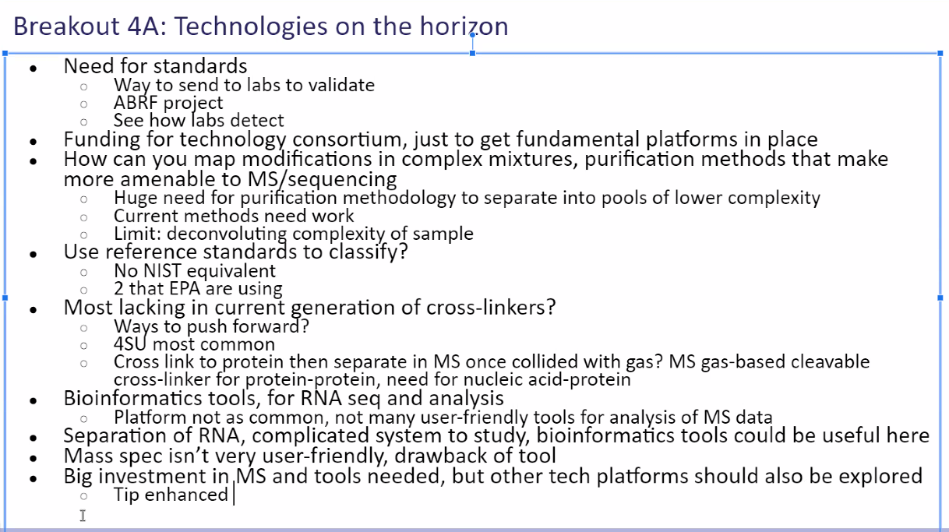
User-friendly platform and gold standard

